Slide 1


GitHub URL:
https://github.com/lavanyanallabelli/Capstone_team4/

Slide 2
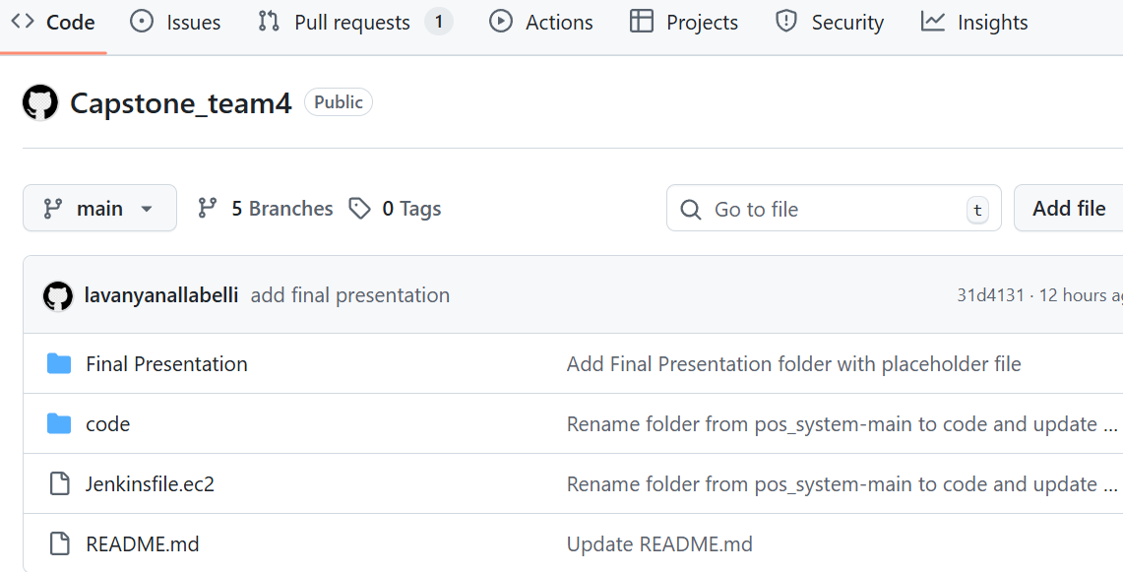
REPOSITORY STRUCTURE

Slide 3
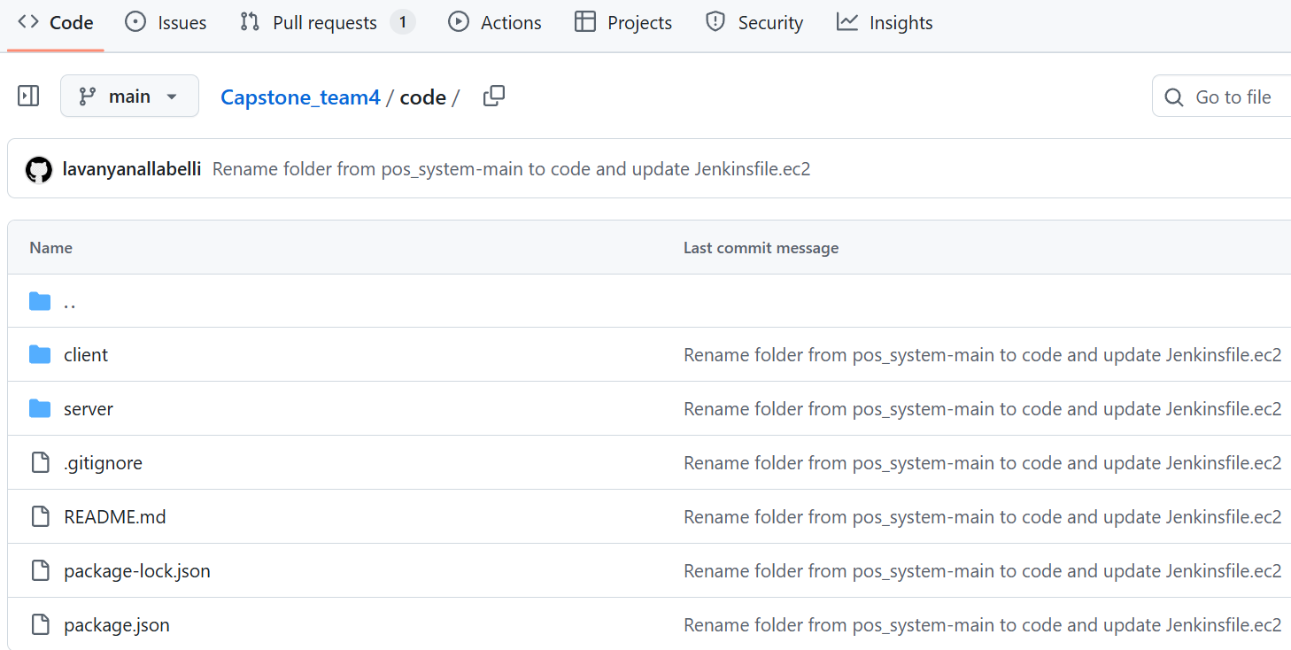
REPOSITORY STRUCTURE

